Slide 1
Domain-specific language for materials modeling
Ivan Kondov, Rodrigo Cortés Mejía, Marvin Müller, Nikolai Pfisterer, Sruthy Sreenivasan

Slide 2
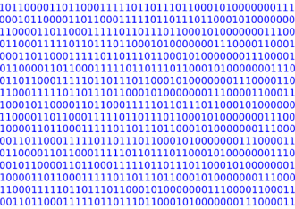
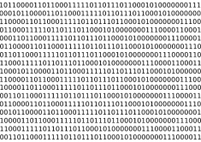
Materials research: traditional approach
Domain-specific code/data
Molecular dynamics
Electronic structure
Domain expert
Machine learning
Synthesis
Lacking:
Reusability
Reproducibility
Scalability
Productivity
Continuum modeling
Characterization

Slide 3
Current approach: scientific workflows
Good
Better
Best
Best? Really? Open issues:
Usability
Productivity
Reusability
Willingness to use
Workflow management systems (WMS)
Adapters
Workflows

Slide 4
Lessons learned
Usability
Scientific workflows concept too complex
Too complex Python APIs and CLI tools
Database queries - yet another domain
Productivity
Too specific Python functions
Lack of data typing
Simple operations not in the workflow
Time-consuming “boilerplate” code
Tedious work to vary parameters
Clumsy API, CLI and GUI
Reusability
Partial solutions
wfGenes: CLI and GUI https://wfgenes.gitlab.io/wfgenes
VRE Middleware: API and GUI https://vre-middleware.readthedocs.io
M. Roozmeh, I. Kondov, In “Workflows in support of large-scale science (WORKS)”, IEEE; pp 9–16 (2020).
M. Roozmeh, I. Kondov, LNCS 13353, 69 (2022).

Slide 5
How to improve (re)usability and productivity?
Generic tools, specific languages¹
¹Markus Voelter, Generic tools, specific languages, Dissertation, TU Delft, 2014.
High
Productivity
SQL
Matlab
databases
data analysis
workflows
materials science
numerics
scheduling
Low
general purpose
domain specific

Slide 6
What is a domain-specific language (DSL)?
Concepts and abstractions of a specific domain
More expressive in its domain
Python
len_1 = 2.0
units_1 = 'meter'
len_2 = 1.0
units_2 = 'nanometer'
diff_1 = len_1 – len_2 # no error but wrong
diff_2 = 2 – len_1 # no error
assert units_1 == units_2 # python(!) error
Better: a custom Python class or the pint package
Even better: native units support. In textS:
len_1 = 2.0 [m]
len_2 = 1.0 [cm]
diff_1 = len_1 – len_2 # no error
diff_2 = 2 + len_1 # domain-specific error
GPLs
C/C++
Python
DSLs
Matlab
Java
Excel
SQL
Regex
Fortran
Julia
…
PostScript
…
textS, textM

Slide 7
textS/textM: Basic concepts and features
Reuse domain-specific libs: ASE, Pint, Pandas, …
Cover full life cycle: use FireWorks
Supporting tools: parser and editor from grammar
Frontends: script, session, Jupyter kernel
Transparent FireWorks, Slurm and data staging
Develop
Execute
Analyze
Archive
Query
Publish

Slide 8
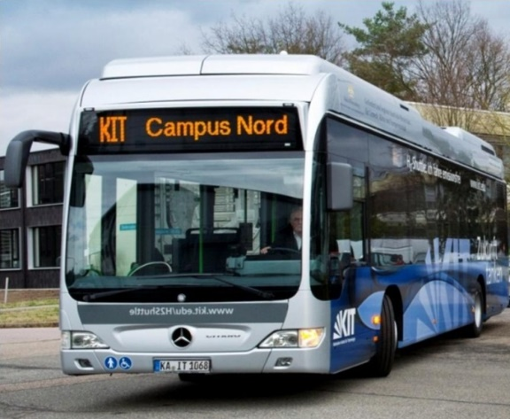
Use case: Oxygen reduction reaction
M, MO_{x}, MO_{x}H_{y} systems
O₂
H₂O
Thermodynamic overpotential:
$$η_{ORR}={U_{0}−U}_{max}$$
$U_{0}=1.23 V$ (RHE)
*
0.5 H₂(g)
0.5 H₂(g)
H⁺ + e⁻
H⁺ + e⁻
(1)
(4)
Critical potential:
*OOH
*OH
$$U_{max}=\sup\left\{U: {∆G}^{\left(i\right)}\left(U\right)≥0 ∀i∈\left[1, 2, 3, 4\right]\right\}$$
(2)
(3)
0.5 H₂(g)
0.5 H₂(g)
H⁺ + e⁻
H⁺ + e⁻
*O
Free energies:
H₂O
$$∆G^{\left(i\right)}\left(U\right)≈∆E^{\left(i\right)}+∆{ZPE}^{\left(i\right)}−T∆S^{\left(i\right)}−z_{i}U$$
J. K. Nørskov et al., J. Phys. Chem. B 108, 17886 (2004).

Slide 9
Workflow implementation
M. Salmanion, I. Kondov, M. Vandichel, P. Aleshkevych, M. M. Najafpour, Inorg. Chem. 61, 2292 (2022). N. Akbari, I. Kondov, M. Vandichel, P. Aleshkevych, M. M. Najafpour, Inorg. Chem. 60, 5682 (2021). M. Vandichel, K. Laasonen, I. Kondov, Top. Catal. 63, 833 (2020). P. Faubert, I. Kondov, D. Qazzazie, O. Yurchenko, C. Müller, MRS Communications 8, 160 (2018).
I. Kondov, P. Faubert, C. Müller, Electrochimica Acta 236, 260 (2017).
All data and workflows available in the Materials Cloud https://archive.materialscloud.org/.

Slide 10
TextM: Electronic structure properties
geom_surface_O = Structure from file 'geometry_files/pt_slab-o.cif' # only the *O species shown
view structure (geom_surface_O)
c_surf_O = constr(9, 28)
fix_surf_O = FixedAtoms where c_surf_O
c_nrm_O = constr(27, 28)
nrm_surf_O = FixedAtoms where c_nrm_O
constr(n, m) = map((x: x < n), range(0, m, 1))
calc_rlx = Calculator vasp >= 5.4.4 ((algo: 'Fast'), (ediff: 1e-06) [eV], (ediffg: -0.01) [eV/angstrom], (encut: 400.0) [eV],
(ibrion: 2), (icharg: 2), (ismear: 0), (ispin: 2), (istart: 0), (kpts: [5, 5, 1]),
(sigma: 0.1) [eV], (xc: 'PBE')),
task: local minimum
calc_nrm = Calculator vasp >= 5.4.4 ((algo: 'Fast'), (ediff: 1e-07) [eV], (encut: 400.0) [eV], (ibrion: 5), (icharg: 2),
(ismear: 0), (ispin: 2), (nfree: 2), (nsw: 1), (potim: 0.005) [angstrom],
(istart: 0), (kpts: [5, 5, 1]), (sigma: 0.1) [eV], (xc: 'PBE')),
task: normal modes
props_O = Property energy ((structure: geom_surface_O), (calculator: calc_rlx), (constraints: (fix_surf_O))
on 76 cores for 4.0 [hours]
nrm_O = Property vibrational_energies, energy_minimum ((structure: props_O.output_structure), (calculator: calc_nrm),
(constraints: (nrm_surf_O)), on 76 cores for 4.0 [hours]
view structure (props_O.output_structure)

Slide 11
TextM: Properties of the chemical species
use exp, log from numpy
zpe_f(vib_ener) = 0.5*sum(vib_ener)
vib_entr_f(vib_energies) = kB * sum(map(entr, vib_energies, map(exp_hob, vib_energies)))
beta = 1.0/(kB*temperature)
exp_hob(ene) = exp(-ene*beta)
entr(ene, eh) = ene * beta * eh / (1.0-eh) - log(1.0-eh)
temperature = 298.15 [K]
kB = 1 [boltzmann_constant]
MO = Species MO (
(energy: props_O.energy[0]),
(zpe: zpe_f(nrm_O.vibrational_energies[0])),
(entropy: vib_entr_f(nrm_O.vibrational_energies[0])),
(temperature: 298.15) [K]
)
print(MO)

Slide 12
TextM: Electrochemical properties
orr1 = Reaction M + O2 + 0.5 H2 = MOOH
orr2 = Reaction MOOH + 0.5 H2 = MO + H2O
orr3 = Reaction MO + 0.5 H2 = MOH
orr4 = Reaction MOH + 0.5 H2 = M + H2O
orr = (reactions: orr1, orr2, orr3, orr4)
orr_free_energies = map((r: r.free_energy[0]), orr)
U_max = min(map((g: -g/(n*e)), orr_free_energies))
orr_overpotential = U_0 - U_max
min(s) = reduce((x, y: if(x<y, x, y)), s)
U_0 = 1.23 [V] # standard reversible potential
n = 1 # number of exchanged electrons, all ORR/OER elementary reactions are one-electron
e = 1 [elementary_charge]
print('U_max:', U_max, 'ORR_overpotential:', orr_overpotential)
FireWorks: 1256 lines of code (Python + YAML)
TextM: 244 lines of code
Complete use-case code: https://gitlab.kit.edu/kit/virtmat-tools/oxycat-use-case

Slide 13
Conclusion, current work, further steps
Very good first experience with textS and textM
Proof-of-principle, a real-life use case, beta release
Currently: First production deployment in a computing project on HoreKa
Further steps
Enhance Jupyter kernel: highlighting, hints, cell states …
Ease textM extensions
Ease integration of further languages

Slide 14
Thank you!
Collaborations:
Claas Müller (U Freiburg, Germany)
Mohammad Mahdi Najafpour (IASBS, Zanjan, Iran)
Matthias Vandichel (U Limerick)
Wolfgang Wenzel (KIT)

Slide 15
Legal notice
This presentation may be used by the participants of ICCS 2025 only and may not be further distributed.
Copyright © 2025 Karlsruhe Institute of Technology (KIT)

