Slide 1

Understanding the Limitations of Deep Transformer Models for Sea Ice Forecasting
Julia Borisova, Andrey Kuznetsov,
Gleb Solovev, Nikolay O. Nikitin
jul.borisova@itmo.ru
Acknowledgments. The research was carried out within the state assignment of
Ministry of Science and Higher Education of the Russian Federation (project № FSER-2024-0004).
International Conference on Computational Science – ICCS 2025,
7 July – 9 July, Singapore

Slide 2

Presentation plan
Introduction – specific of sea ice prediction task;
Problem statement – spatio-temporal data and its forecasting;
Architectures – transformers and baselines;
Experimental setup – description of dataset and models used;
Results – validation of model’s inference;
Conclusion – summary and discussion questions.

Slide 3
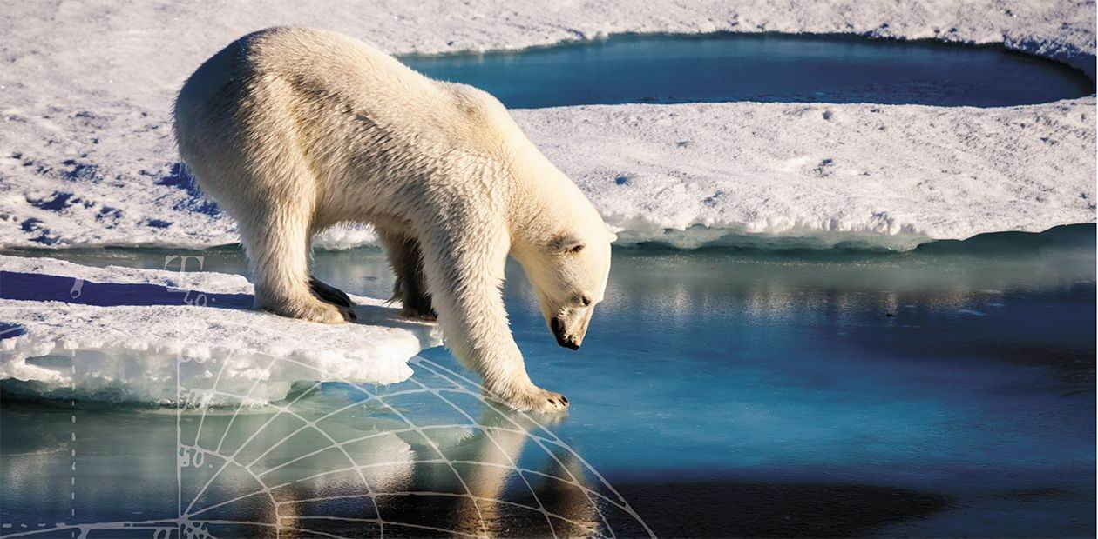
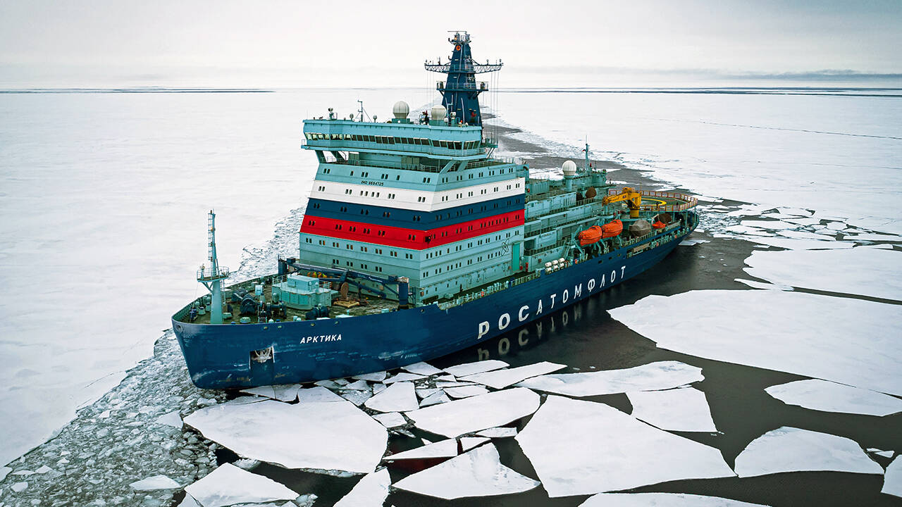
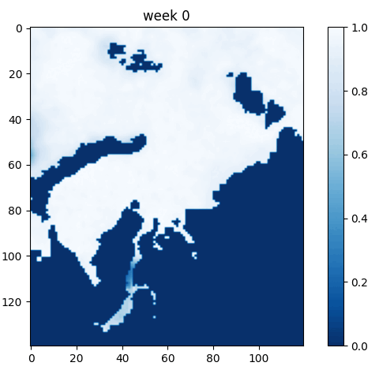
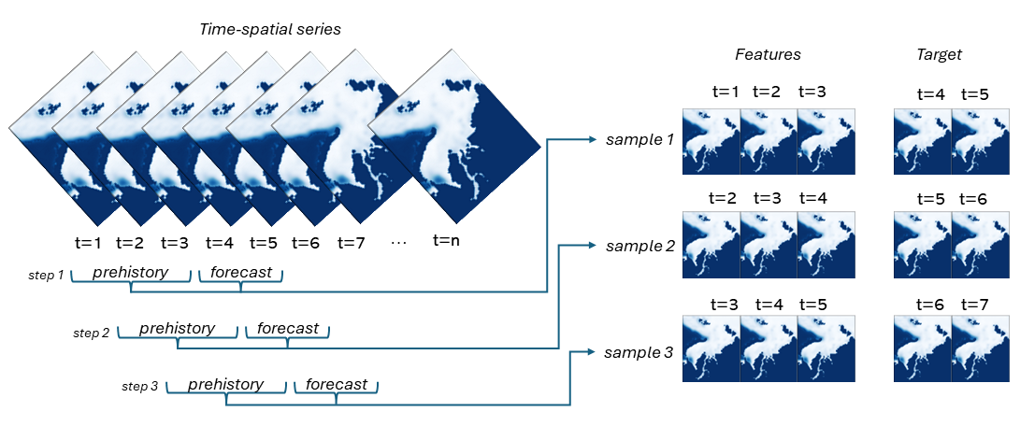
Introduction
Sea ice conditions forecasting supports:
offshore oil industry;
navigation ;
environmental changes.
Forecasting systems require:
long-term forecast;
ice phases reconstruction;
continuous field with accurate absolute values.
Kara sea ice example

Slide 4
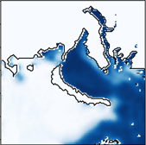
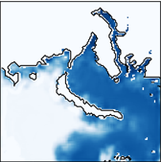
Problem statement
Spatio-temporal data is multidimensional – long-term forecast is resource-intensive;
Spatial patterns are smooth and characterize ice edge position;
Ice dynamics id multiscale, non-stationary and contain an irremovable stochastic component;
Task – spatio-temporal data forecasting
pre-history
prediction
Sea ice has very complex periodic patterns (e.g. annual periodicity for sea ice), the reproduction of which is crucial for forecasting.
Sliding window dataset preparation
Hypothesis: the practical applicability of regular-grid transformer-based models for spatio-temporal data with specific periodic properties is very limited.

Slide 5
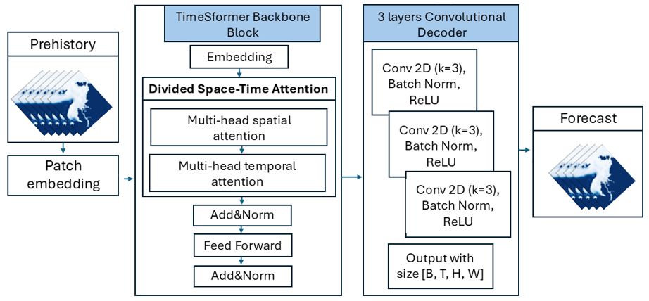
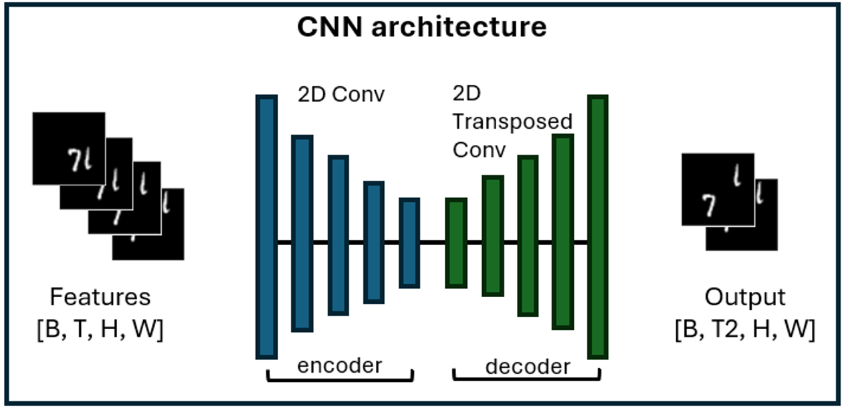
Architectures
Baselines
Application of the TimeSformer to the long-term sea ice forecasting
CNN-2D was implemented as a CNN with an encoder-decoder architecture: 5 convolutional 2D layers with ReLU activation function and its transposed mirror.
CNN-3D uses a time component sensitive CNN encoder-decoder architecture with 3D convolution. Each of the encoder and decoder parts con sists of 2 layers, forming a symmetric structure.
TimeSformer implements the Divided Space-Time attention mechanism, which we believe is the promising basis for the sea ice prediction task;
The transformer head responsible for classification was replaced by a convolutional decoder for prediction of ice concentration changes over multiple frames.

Slide 6
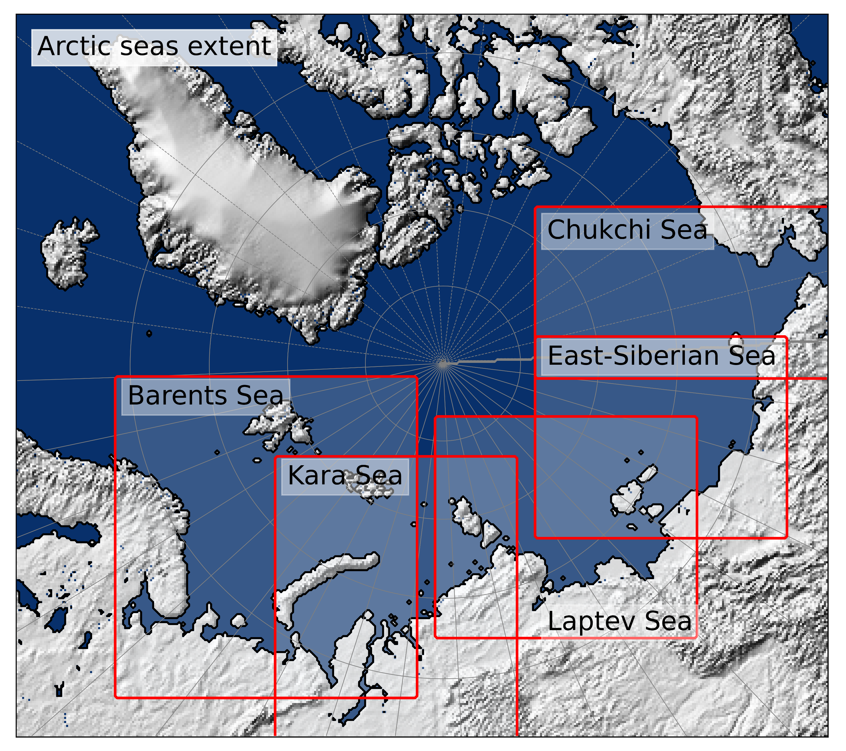
Experimental setup
Dataset:
OSI SAF Global Sea Ice Concentration product;
The spatial resolution of the images is reduced to 14 km;
Forecast horizon - one year ahead;
Pre-history length was set to two years;
The time resolution - 7 days;
Period for train - 1979 to 2020 years;
Period for test - 01/01/2020 to 31/12/2023.
Quality metrics:
Mean Absolute Error (L1loss) – MAE;
Structural Similarity index measure – SSIM;
Binary accuracy - binarization threshold of 0.2 to evaluate the ice edge prediction
The spatial position of each sea – test areas

Slide 7
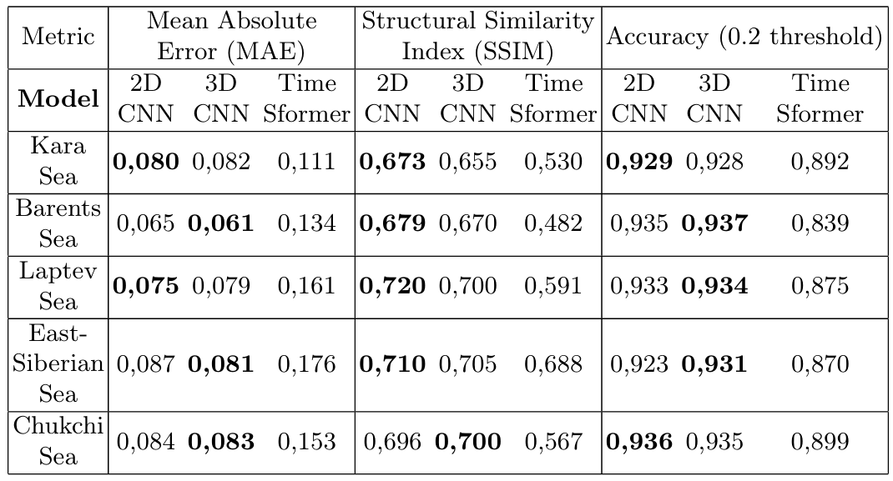
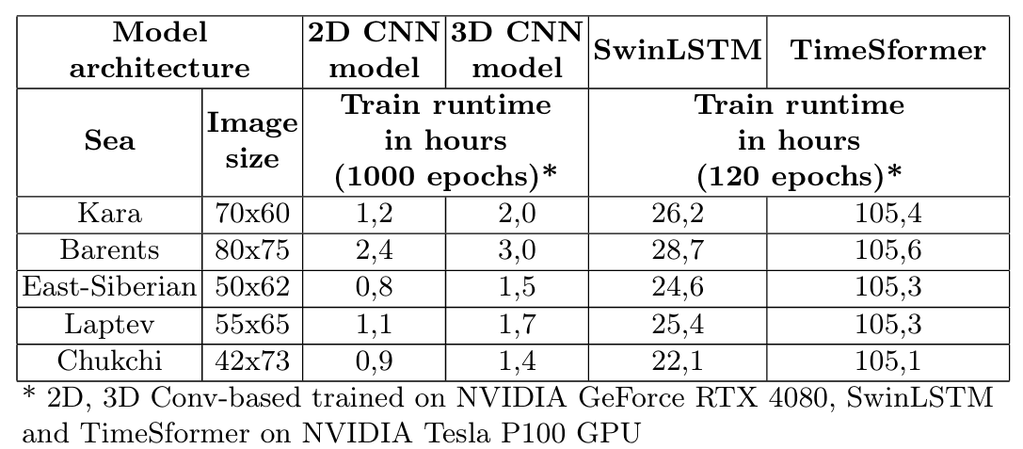
Results – Metrics
Quality metrics averaged over 2020-2023
According to the metrics, the TimeSformer has a lower quality compared to CNN models;
TimeSformer requires server equipment and less epochs for train.
Bold are the best
Time spent on training models on test areas
The spatial position of each sea – test areas

Slide 8
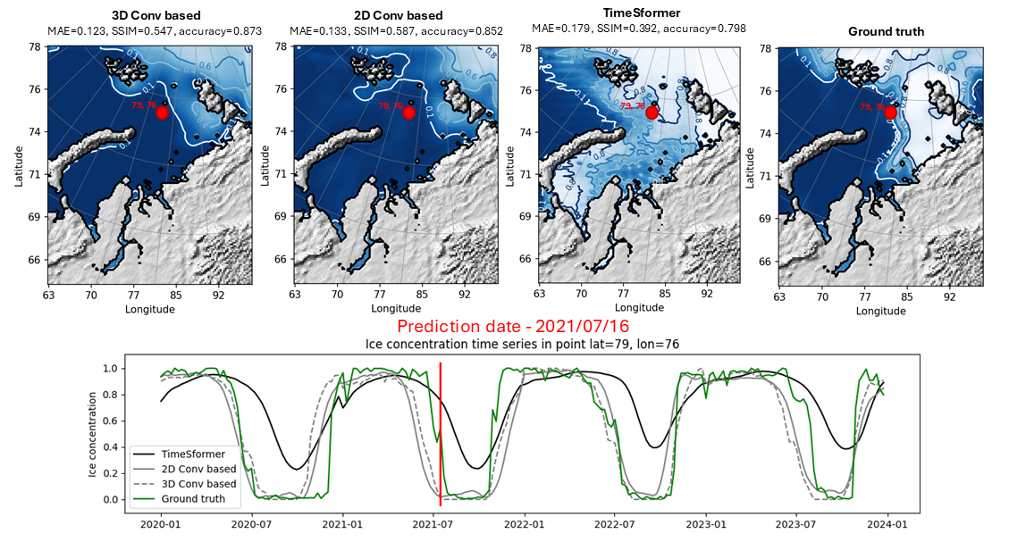
Results – Visualization
To understand which period of the year makes the largest contribution to the average error, the course of the metric over the year was visualized;
Vertical lines mark the beginning of each year.
There is a pattern in the plot of the TimeSformer error that differs from other models- the error increases significantly in the summer months.
Point time series make sure that the pattern of error does not change over the years.
Comparison of spatial distribution of values on prediction for 2021/07/16 in Kara Sea
TimeSformer does not predict ice melt during the summer period correctly.

Slide 9
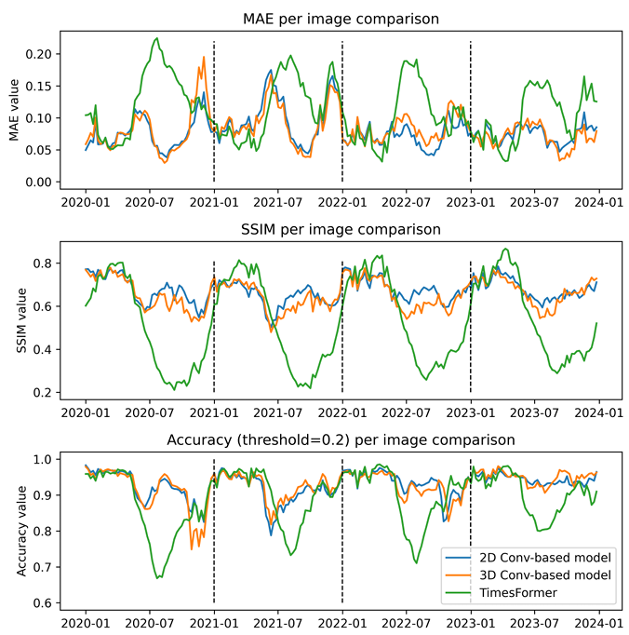
Results – Visualization
Ice concentration maps for each prediction time step and metrics foe each steps was visualized.
Vertical lines mark the beginning of each year.
There is a pattern in the plot of the TimeSformer error that differs from other models- the error increases significantly in the summer months.
Point time series make sure that the pattern of error does not change over the years.
Metrics for each time step of prediction for Kara sea
TimeSformer does not predict ice melt during the summer period correctly – ice phases are lost.

Slide 10
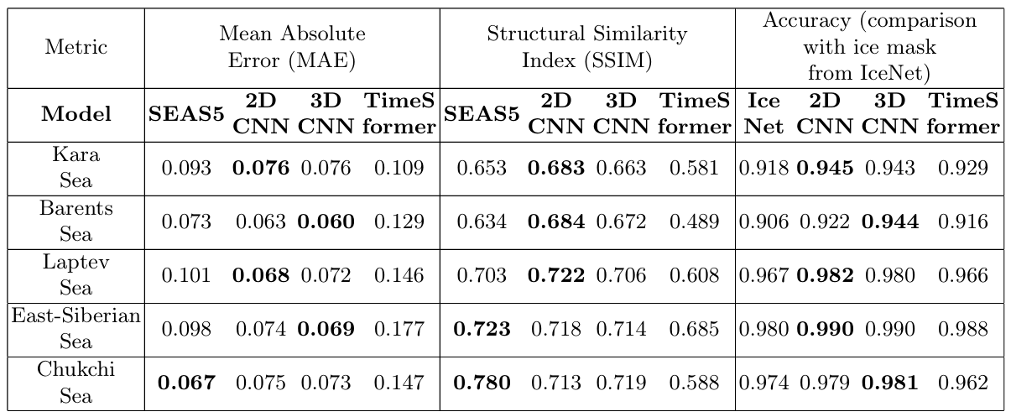
Results – SOTA comparison
Comparison of averaged metrics with SOTA-solutions (SEAS5 and IceNet), 7 month ahead forecast
SEAS5, ECMWF’s fifth generation seasonal forecasting system, is physics-based and uses systems of differential equations.
It provides a global Arctic forecast 7 months ahead and includes 51 ensemble elements.
IceNet forecasting system was used for estimation ice edge prediction quality.
It based on an ensemble of neural networks and become a data-driven SOTA.
IceNet consists of 25 ensemble members, each of which is a U-net architecture model. Eleven climate and ice cover variables are used as input parameters. As the solution provides a monthly probabilistic forecast for 6 months, we used a confidence threshold of 0.8 for the probabilistic model.
the forecast of all models is limited to the SEAS5 horizon
Both the absolute values of ice concentration and the ice edge position predicted by convolution-based models are of better quality than SOTA.
These models can therefore form a foundation for solutions that go beyond the current state-of-the art.

Slide 11

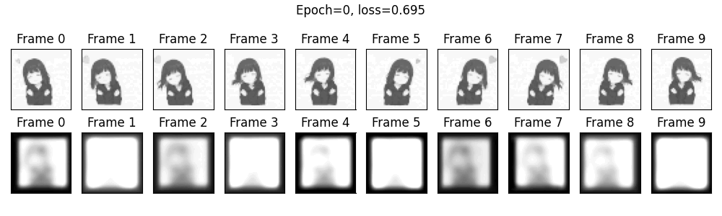
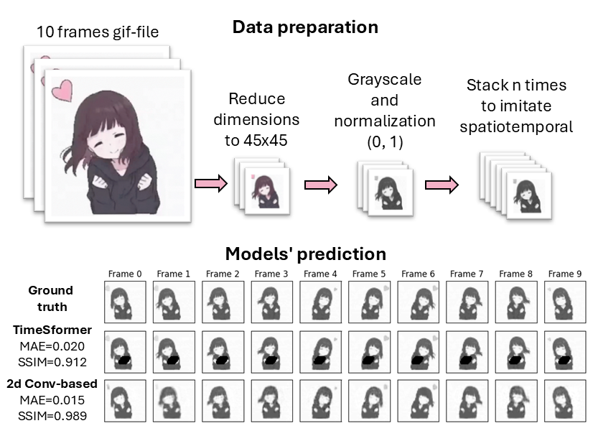
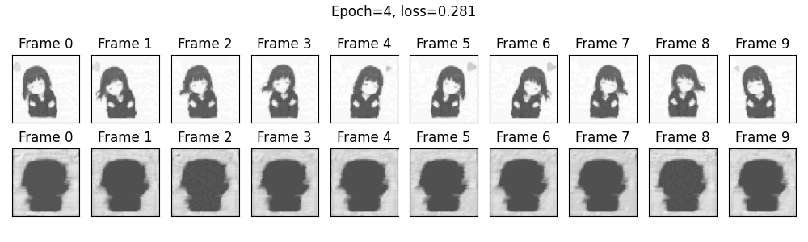
Results – toy example
To ensure that the problem of transformers in forecasting periodic spatio-temporal data is not specific for analyzed case only, we performed an additional experiment on a 10-frame video.
Due to the small training set, we were able to run TimeSformer for 4000 epochs, the CNN was trained for 100000 epochs, the stopping criterion is the number of epochs without L1loss improvement
Convergence of models on synthetic data
2D CNN:
TimeSFormer:

Slide 12
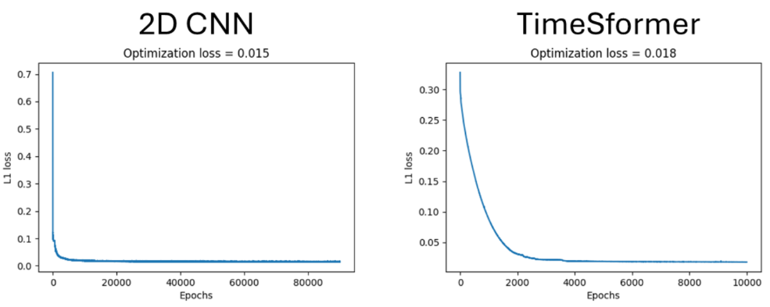
Results – toy example
TimeSformer reaches a plateau at 0.02 and produces artifacts in the center of the image.
The CNN model converges asymptotically to zero error.
Convergence of models on synthetic data
Convergence plots confirm that the number of epochs for training is sufficient.
2D CNN:
Difference in the model optimization process:
CNN improves the image ”from general to particular” while simultaneously optimizing the average error by the matrix.
The transformer initially sets a smaller weight for the part of the image with the least variability and improves it only after the contours match perfectly.
TimeSFormer:

Slide 13

Conclusion
Transformers underperform on periodic spatio-temporal data (e.g., sea ice dynamics), failing to capture annual cycles and producing artifacts.
CNNs outperform transformers in sea ice forecasting, reducing MAE by 30% and improving SSIM by 10% over SOTA physics-based and ensemble models.
The linear nature of transformers limits their ability to model non-linear, periodic patterns, while CNNs better approximate such dynamics.
Synthetic experiments confirm transformers struggle with repetitive video-like data, reinforcing the need for task-specific architecture selection.
Lightweight CNNs are more efficient and accurate than resource-intensive transformers for regional sea ice prediction.
Code and materials are available on GitHub:
https://github.com/ITMO-NSS-team/sea_ice_transformers

Slide 14
Thank you for your attention!
Understanding the Limitations of Deep Transformer Models for Sea Ice Forecasting
Julia Borisova, Andrey Kuznetsov, Gleb Solovev, Nikolay O. Nikitin
jul.borisova@itmo.ru
International Conference on Computational Science – ICCS 2025,
7 July – 9 July, Singapore

