Slide 1
25th International Conference on Computational Science
(Singapore)
Cattle Identification using 2D Mask Retention
Network
Author’s: Niraj Kumar, Sakshi Ranjan, Sanjay Kumar Singh
Affiliation: Indian Institute of Technology (BHU), Varanasi

Slide 2
Motivation & Problem Statement
Why cattle identification matters:
Essential for herd management, disease control, and traceability.
Limitations of traditional methods:
Ear tags, RFID: labor-intensive, prone to loss/damage.
Need for a robust, scalable, and automated solution.

Slide 3
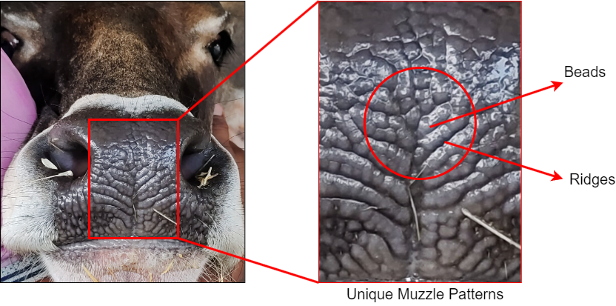
Why Muzzle Patterns?
Like human fingerprints - Unique and Permanent
Not prone to detachments or degradation like physical tags
Suitable for Real World Farm Settings with minimal hardware

Slide 4
Challenges in Cattle Recognition:
Visual similarity among cattle.
Lighting variations, occlusion, movement.
CNNs capture local patterns well but struggle with global context.
Transformers handle global features but are computationally expensive.

Slide 5
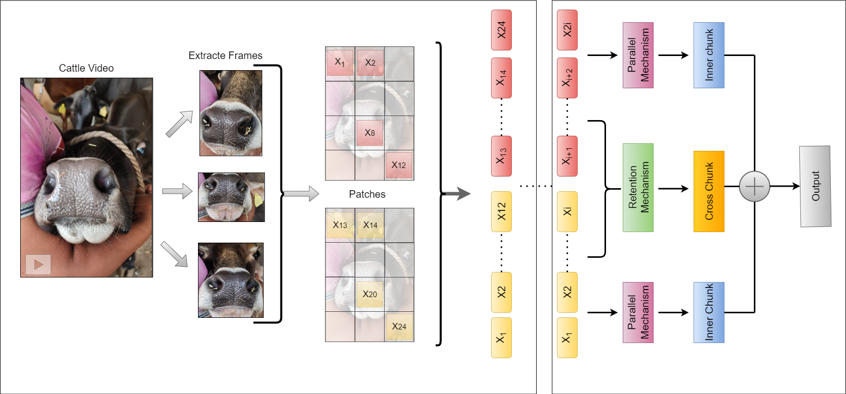
Proposed Architecture Overview:
Combination of Vision Transformer(ViT) and Retention Networks.
Uses 2D Masking to capture spatial and temporal dependencies efficiently.
Model pipeline includes:
1) Video → Frames → Patches → Embeddings
2) Frame-wise ViT processing
3) Temporal modeling via cross-chunk retention.

Slide 6
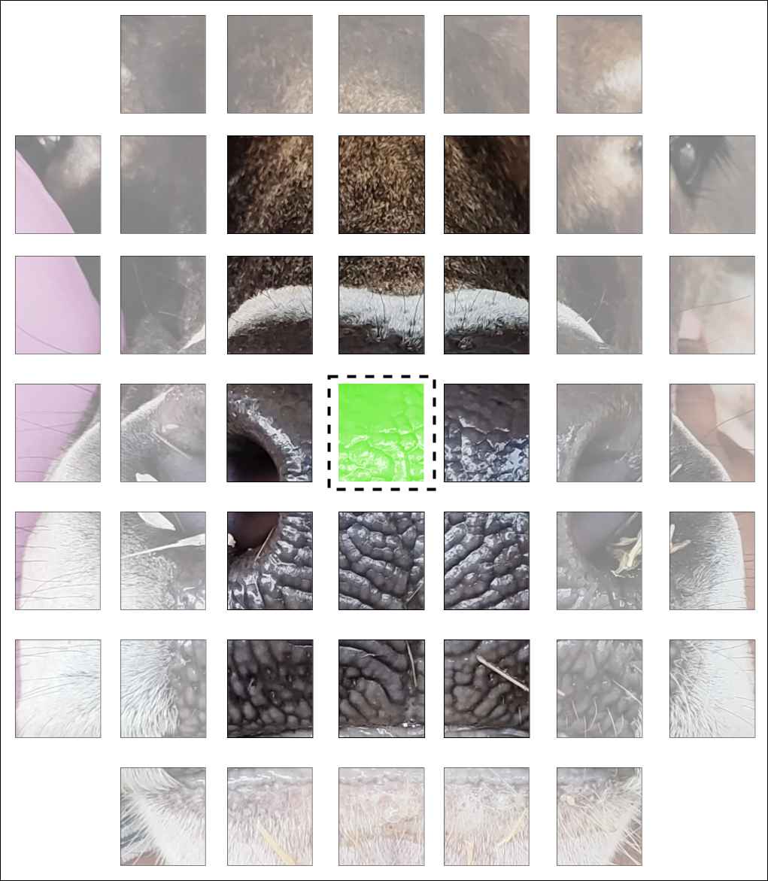
2D Mask Retention Mechanism:
Introduces decaying 2D spatial masks to model patch relationships.
Retains spatial/temporal memory with less computation than ViT’s.
Improves feature attention across frames
Reduces quadratic complexity to near-linear.

Slide 7
Dataset and Experimental Setup:
Custom-collected muzzle video dataset (50 cattle).
High-resolution frames split into Training (80%) and Validation (20%).
Experiments conducted using Tensorflow/keras on modest hardware.

Slide 8
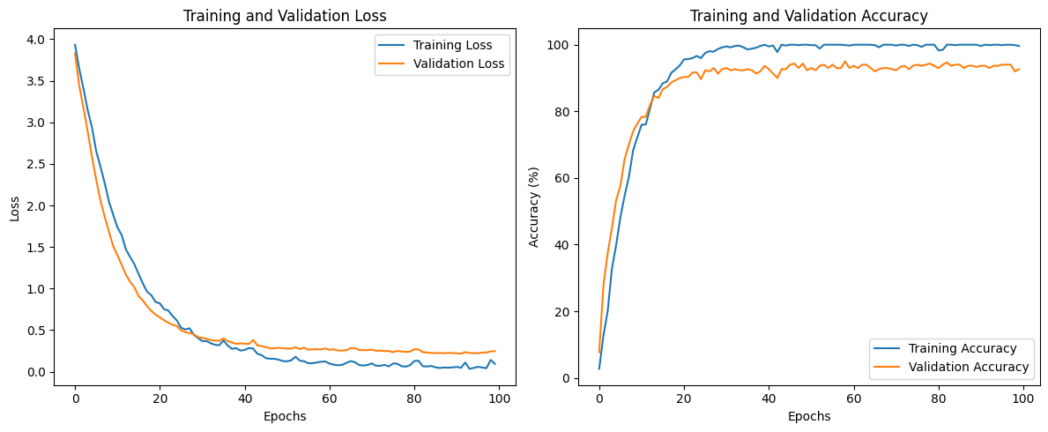
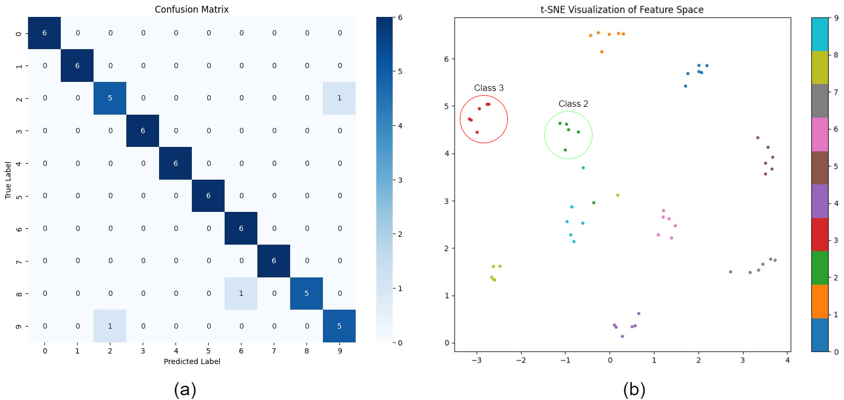
Results and Comparisons:
Achieved 91.5% accuracy, outperforming:
1)ViViT(91.3%)
2)MViT (91.0%)
3)TAN, X3D, I3D
Strong metrics:
1)Precision: 91.0%
2)Recall: 90.8%
3)F1 Score: 90.9%

Slide 9
Ablation Studies & Insights:
Higher resolutions (128×128) → better accuracy.
Performance degrades slightly with more classes.
CrossEntropy outperforms other loss functions.
t-SNE and Confusion Matrix show robust feature separation and minor misclassification.

Slide 10
Conclusion & Future Work:
Proposed method is accurate, scalable, and efficient.
Handles occlusion and lighting variations well.
Limitations: small dataset, semi-controlled setting.
Future Directions:
1)Dataset expansion, domain adaptation.
2)Unsupervised learning.
3)Edge deployment and multimodal fusion (e.g., face, gait).

Slide 11
Thank You

